Slide 1
Veterans Affairs Web Page Data Project
By: Anurag Perakalapudi and Aneesh Kalla

Slide 2
01
Goal
Write Statement of Data Mining Goal

Slide 3
Veterans Affairs
Veterans Affairs processes claims that Veterans make for financial aid
Applying for claims is a difficult and tedious process
Many Veterans don’t get the benefits they deserve

Slide 4
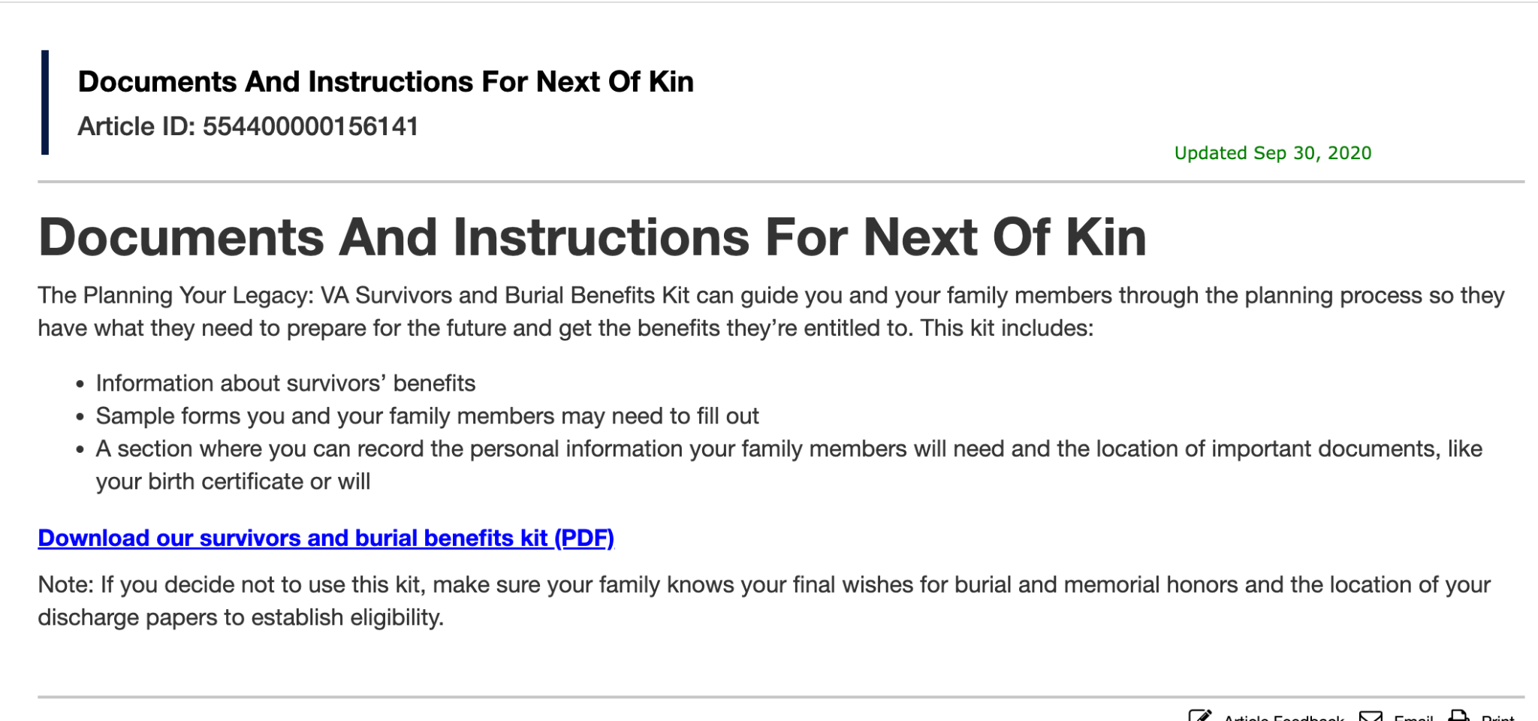
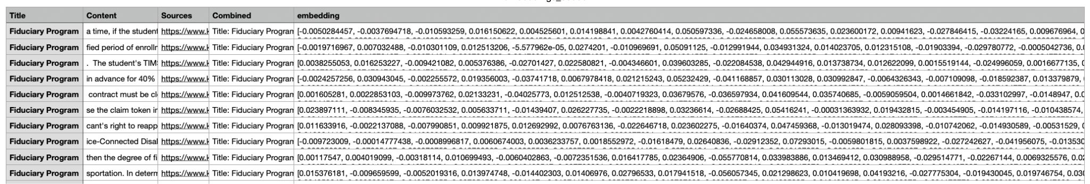
Description of Dataset
Data is from knowva.ebenefits.va.gov
There are webpages with information about the claims process
Used Selenium Webdriver to extract text from html pages

Slide 5



Website Format
Strategy to read Content
Link Pages
Article Pages
Click all links
Read Every Article

Slide 6

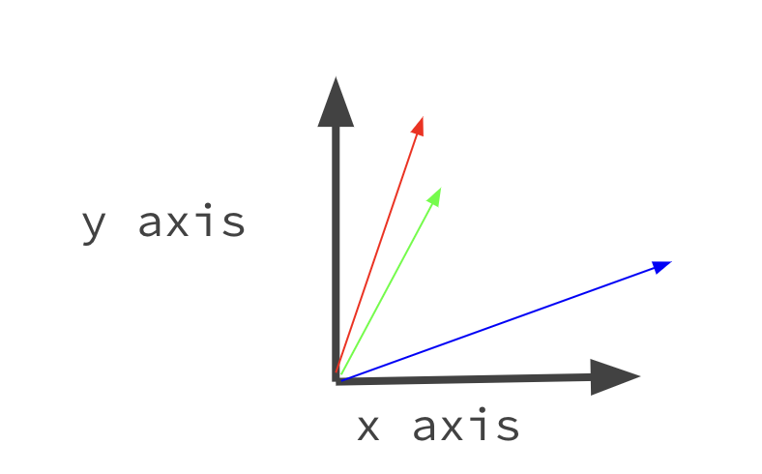
GOAL
Each html page is associated with a category (ex: burials)
We want to use embeddings of text to predict the article category

Slide 7
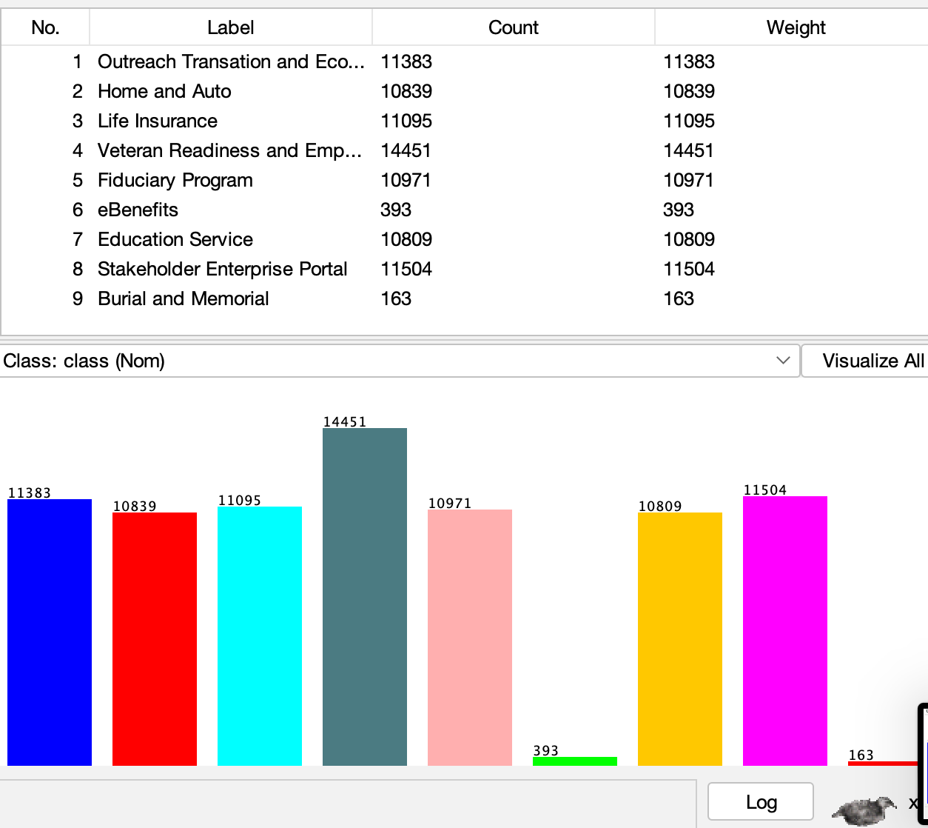

Slide 8
Preprocessing
Preprocessing done in a jupyter notebook
Each web page article was broken into smaller chunks of text
chatGPT API was used to create embeddings of text
Duplicate rows were removed
80,000 instances with 3072 embedding “features”

Slide 9
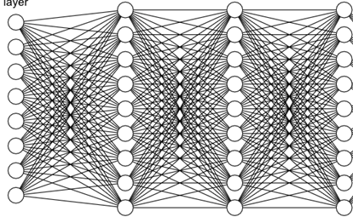
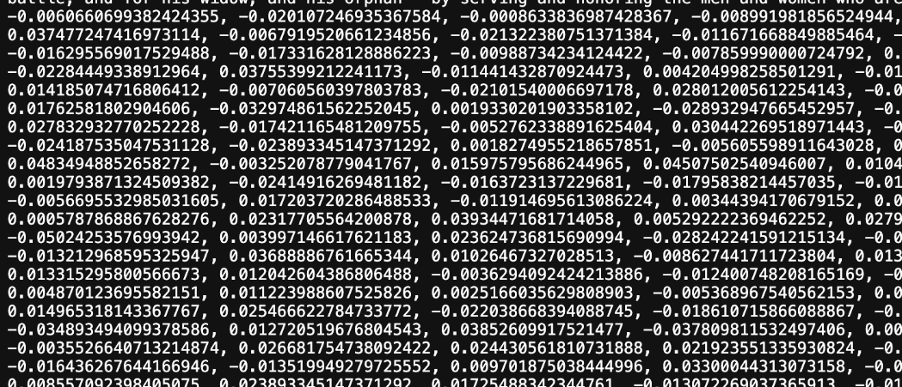
Embeddings
“What is the age of eligibility for Veteran Benefits?”
Self attention layers
Multi-Dimensional Embedding

Slide 10
What is an Embedding
Question: I’m an injured Veteran, how much money do I qualify for?
Article 1: Injured Veterans can apply for $5000 compensation
Article 2: Claims can take up to 6 months to process
y axis
x axis
(this is a 2D example, actually happens in much higher dimension)

Slide 11

Attribute Selection Algorithms
Correlation
Correlation analyzes each individual feature to see how correlated it is with each class. In addition to being one of our attribute selection algorithms, we also used it initially to prune our 3072 feature dataset into 100.

Slide 12
Attribute Selection Algorithms
(Non-Weka) No Attribute Removal
As a baseline method, we keep all the attributes in our data. This is also helpful as a control case to help us put into perspective the other results of our trials.

Slide 13
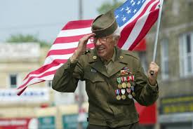
Attribute Selection Algorithms
Principal Components
PCA (Principal Component Analysis) is a attribute reduction technique that transforms the original attributes into a linear combination of attributes called Principal Components that tries to maximize the variance in the data. The PCA ranks n (# of original attributes) principal components by the amount of variance they capture. By keeping a variance threshold, we can remove some attributes which do not contain enough variance for our liking.

Slide 14
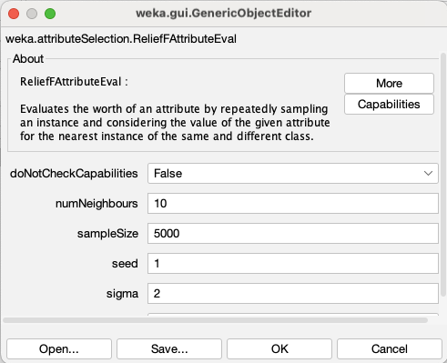
Attribute Selection Algorithms
ReliefFAttributeEval
ReliefF attribute evaluation is an attribute selection algorithm that ranks the attributes by useful they are in distinguishing between the class types.
ReliefF is effective for handling noisy data since it focuses on the nearest neighbors, which is helpful for our data.
ReliefF attribute evaluation finds the similarities between different instances and the give a weight for each attribute in relation to the class .Here is an example of an attribute ranking using ReliefFAttributeEval:

Slide 15
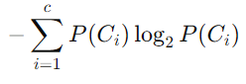
Attribute Selection Algorithms
GainRatioAttributeEval
GainRatioAttribute Eval ranks attributes by their gain ratio in relation to the class attribute. Entropy is calculated by the following formula where P(C_{i}) is the probability of the attribute predicting the class.

Slide 16
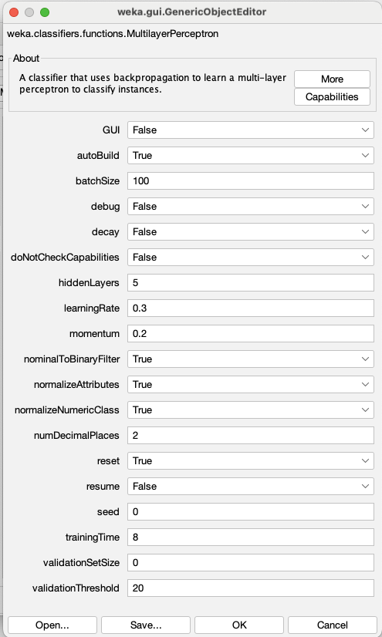
Classification Algorithms
Multi-layer Perceptron (MLP):
A Multi-layer Perceptron is a simplistic neural network that takes the instances as the input and the class as the output. We can tune hyperparameters for the MLP. Here are our hyperparameters:

Slide 17
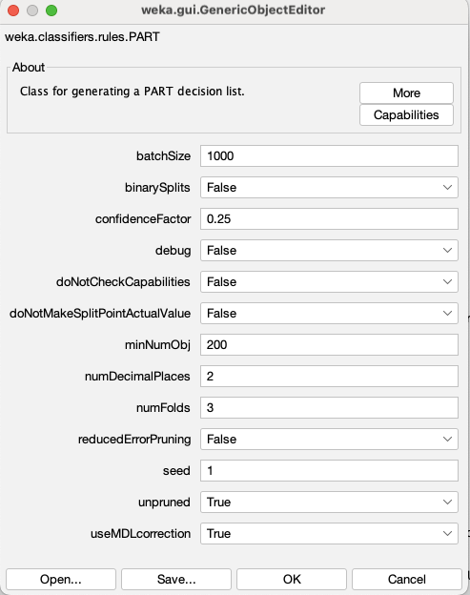
Classification Algorithms
PART (Partial Decision Trees)
PART (Partial Decision Trees) is a rule-based classification algorithm with a connection with the a decision tree. It works by making a decision tree for the dataset and then extracting rules from the trees and modifying the new trees until PART creates a set of rules for the dataset. Here are the hyperparameters for our PART initialization.

Slide 18
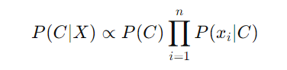
Classification Algorithms
Naive Bayes
Probabilistic Classifier based on calculating the prior probability based on the formula to the side. P(C|X) describes the function for the previous feature X for the class C.

Slide 19
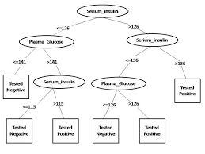
Classification Algorithms
J48
J48 is Weka’s implementation of the C4.5 algorithm, which works by building a decision tree by recursively splitting a dataset based on which feature has the most significant information gain.

Slide 20
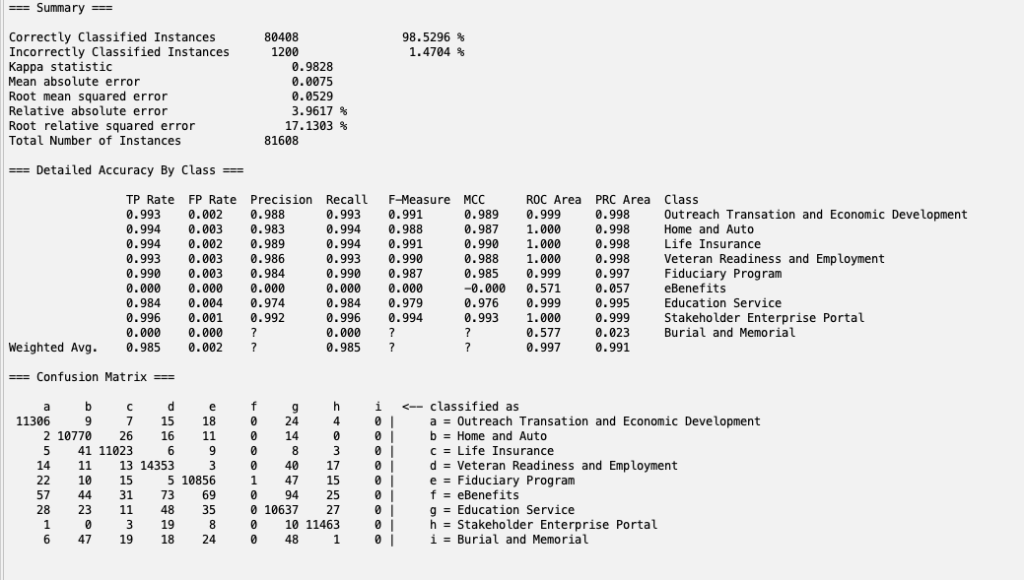
No Attribute Removal with MLP:
Results

Slide 21
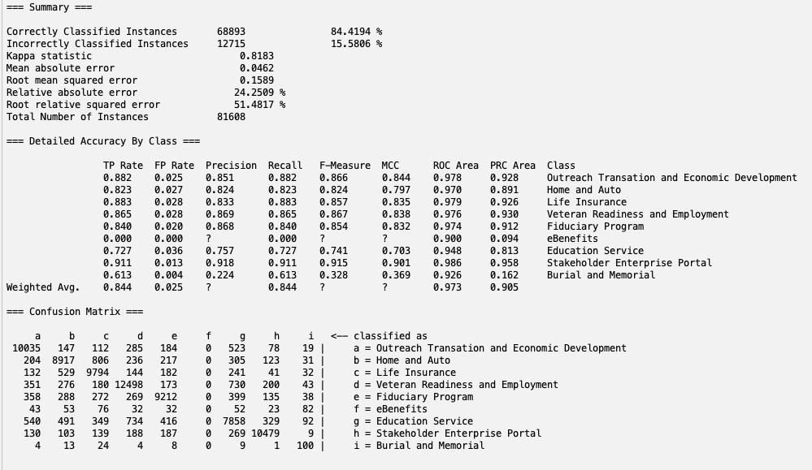
No Attribute Selection with PART:
Results

Slide 22
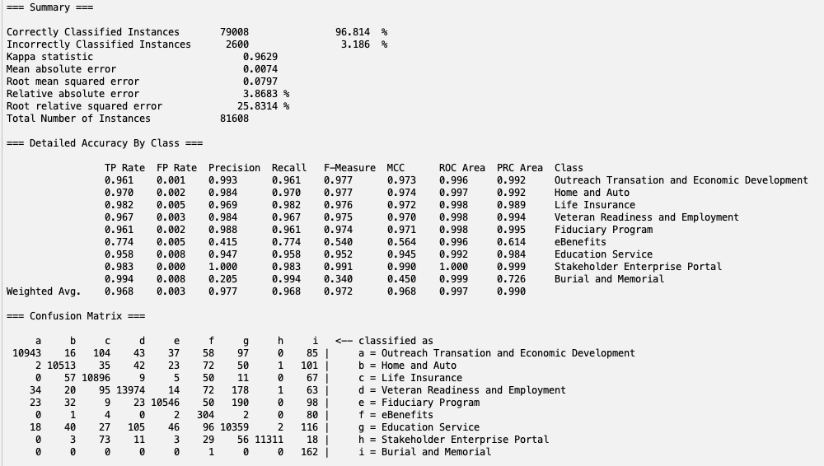
No Attribute Selection with Naive Bayes:
Results

Slide 23
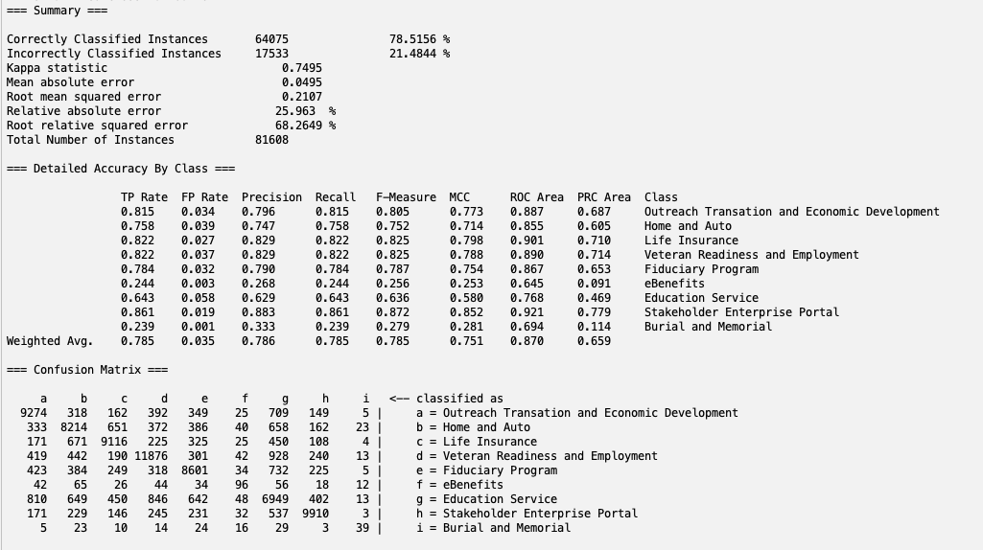
No Attribute Selection with J48:
Results

Slide 24
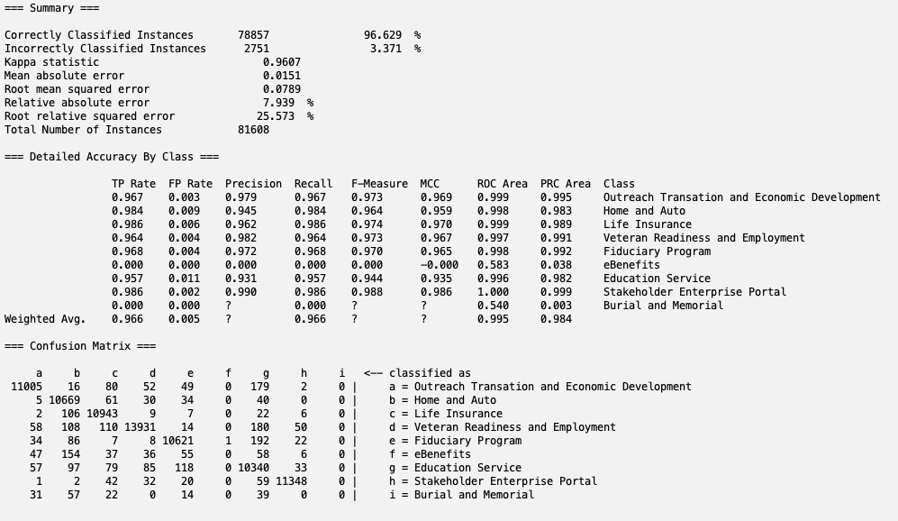
PCA with MLP:
Results

Slide 25
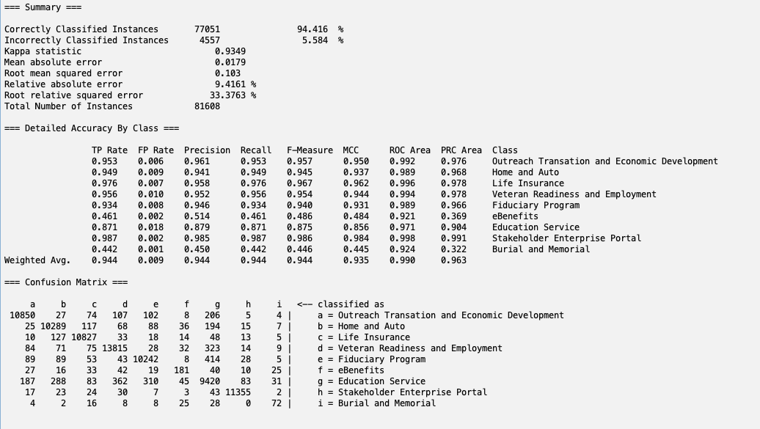
PCA with PART:
Results

Slide 26
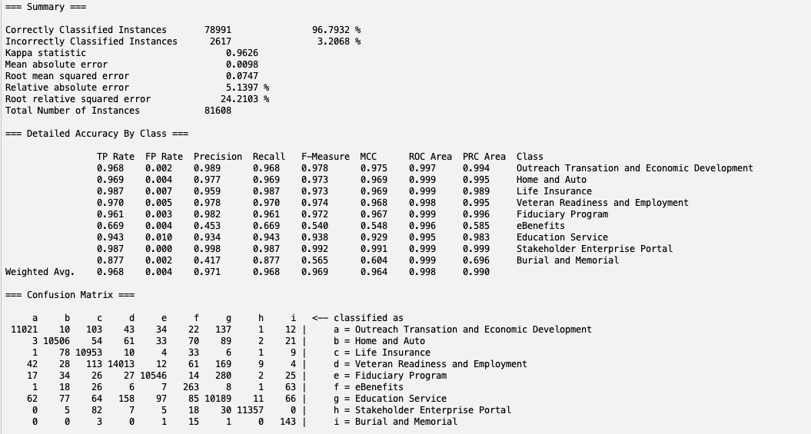
PCA with Naive Bayes:
Results

Slide 27
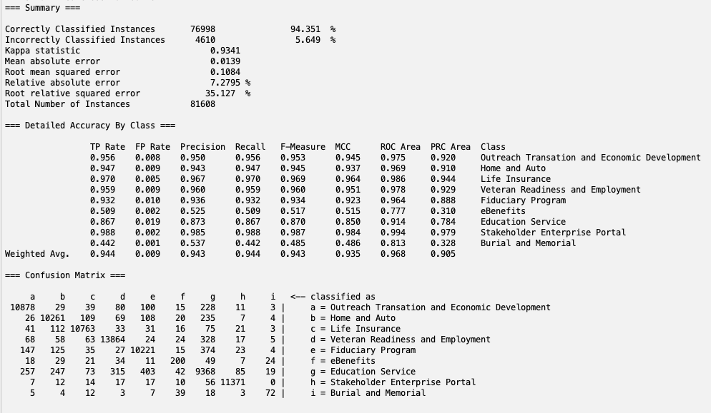
PCA with J48:
Results

Slide 28

ReliefF with MLP:
Results

Slide 29
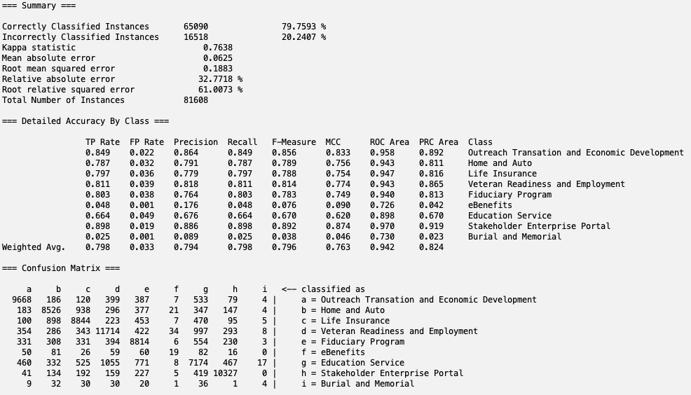
ReliefF with PART:
Results

Slide 30
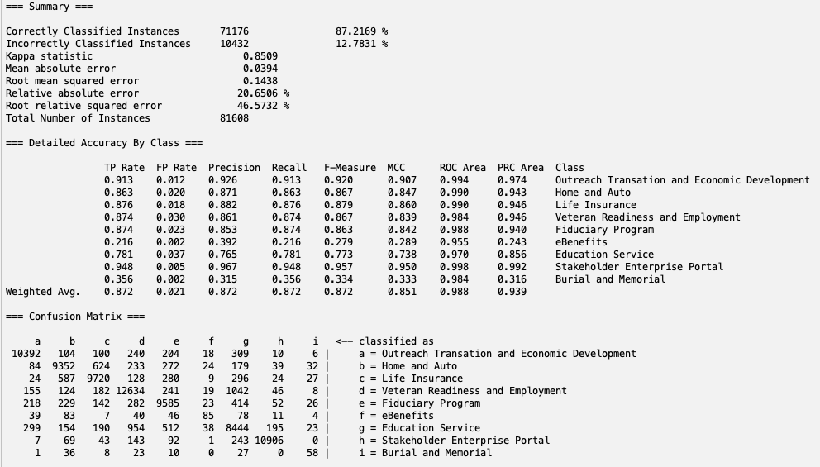
Results
ReliefF with Naive Bayes:

Slide 31
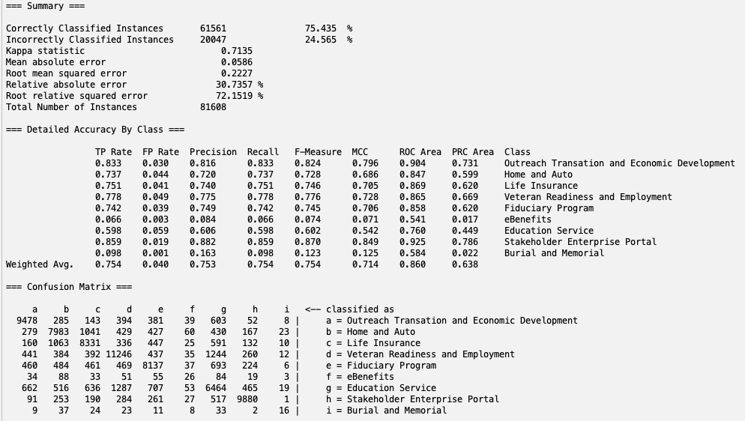
ReliefF with J48:
Results

Slide 32

GainRatioAttributeEval with MLP:
Results

Slide 33
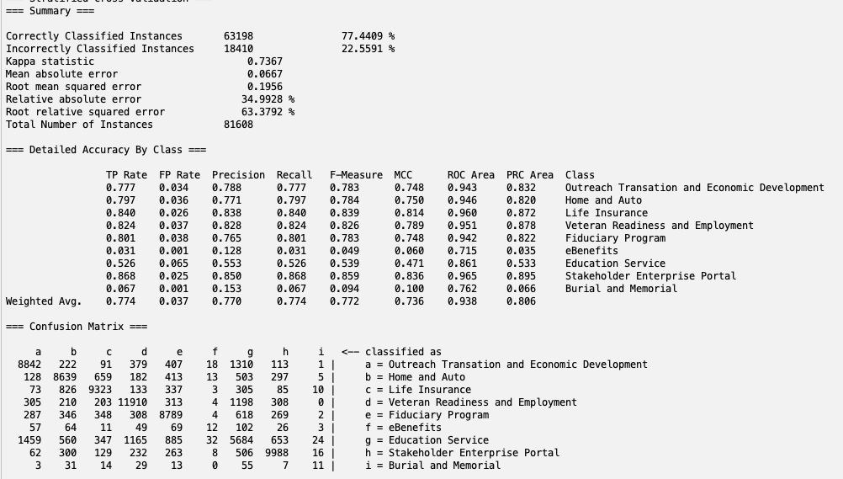
GainRatioAttributeEval with PART:
Results

Slide 34
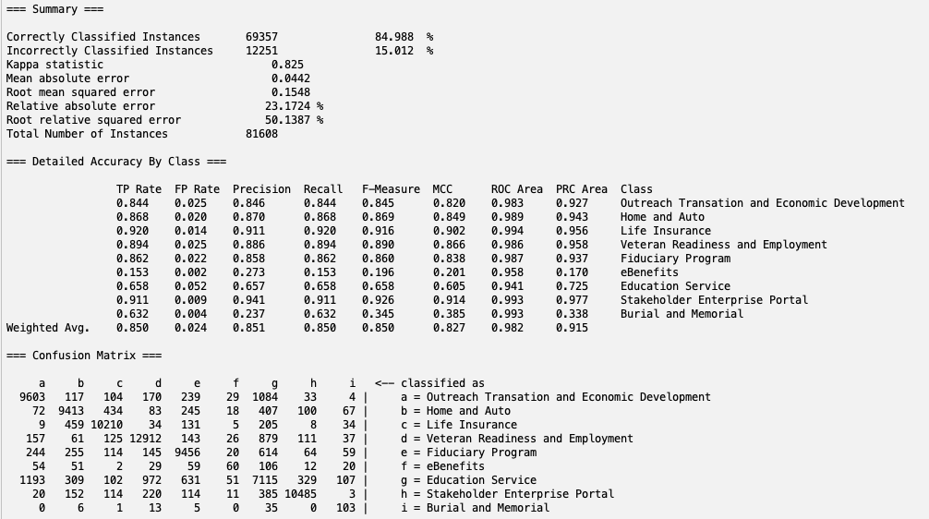
GainRatioAttributeEval with Naive Bayes:
Results

Slide 35
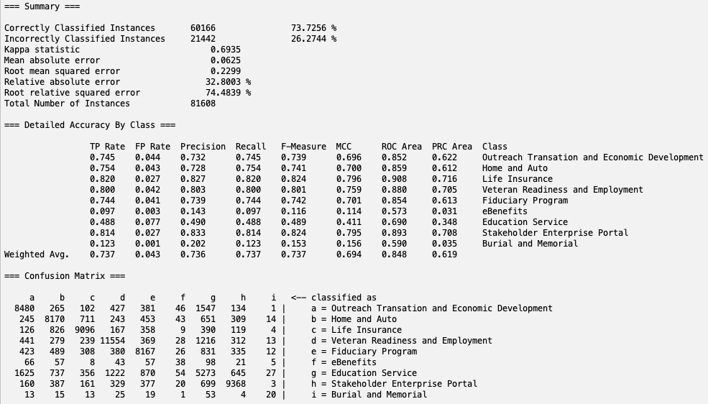
GainRatioAttributeEval with J48:
Results

Slide 36

Correlation with MLP:
Results

Slide 37
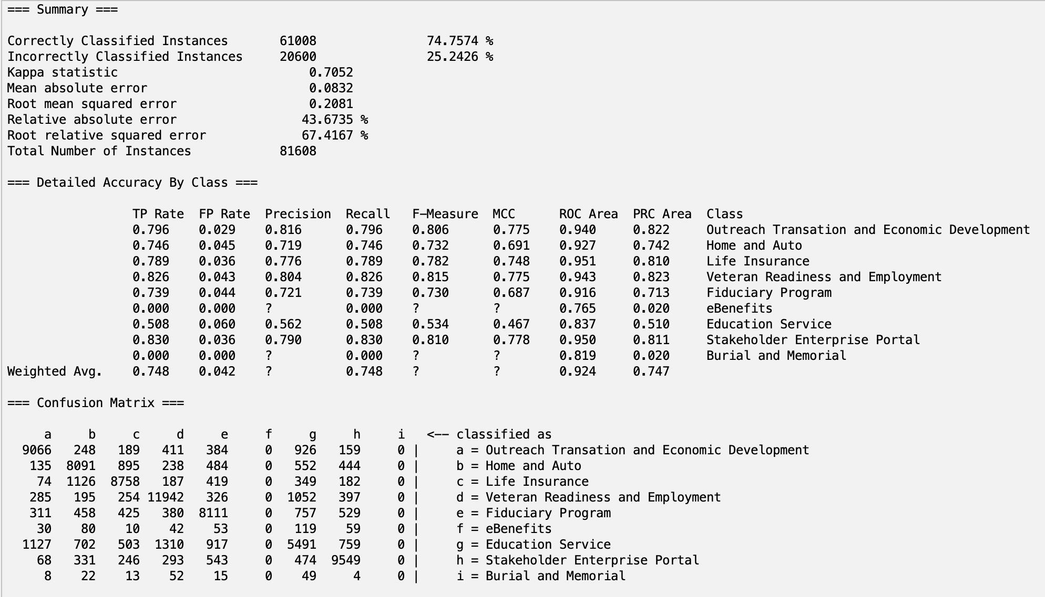
Correlation with PART:
Results

Slide 38
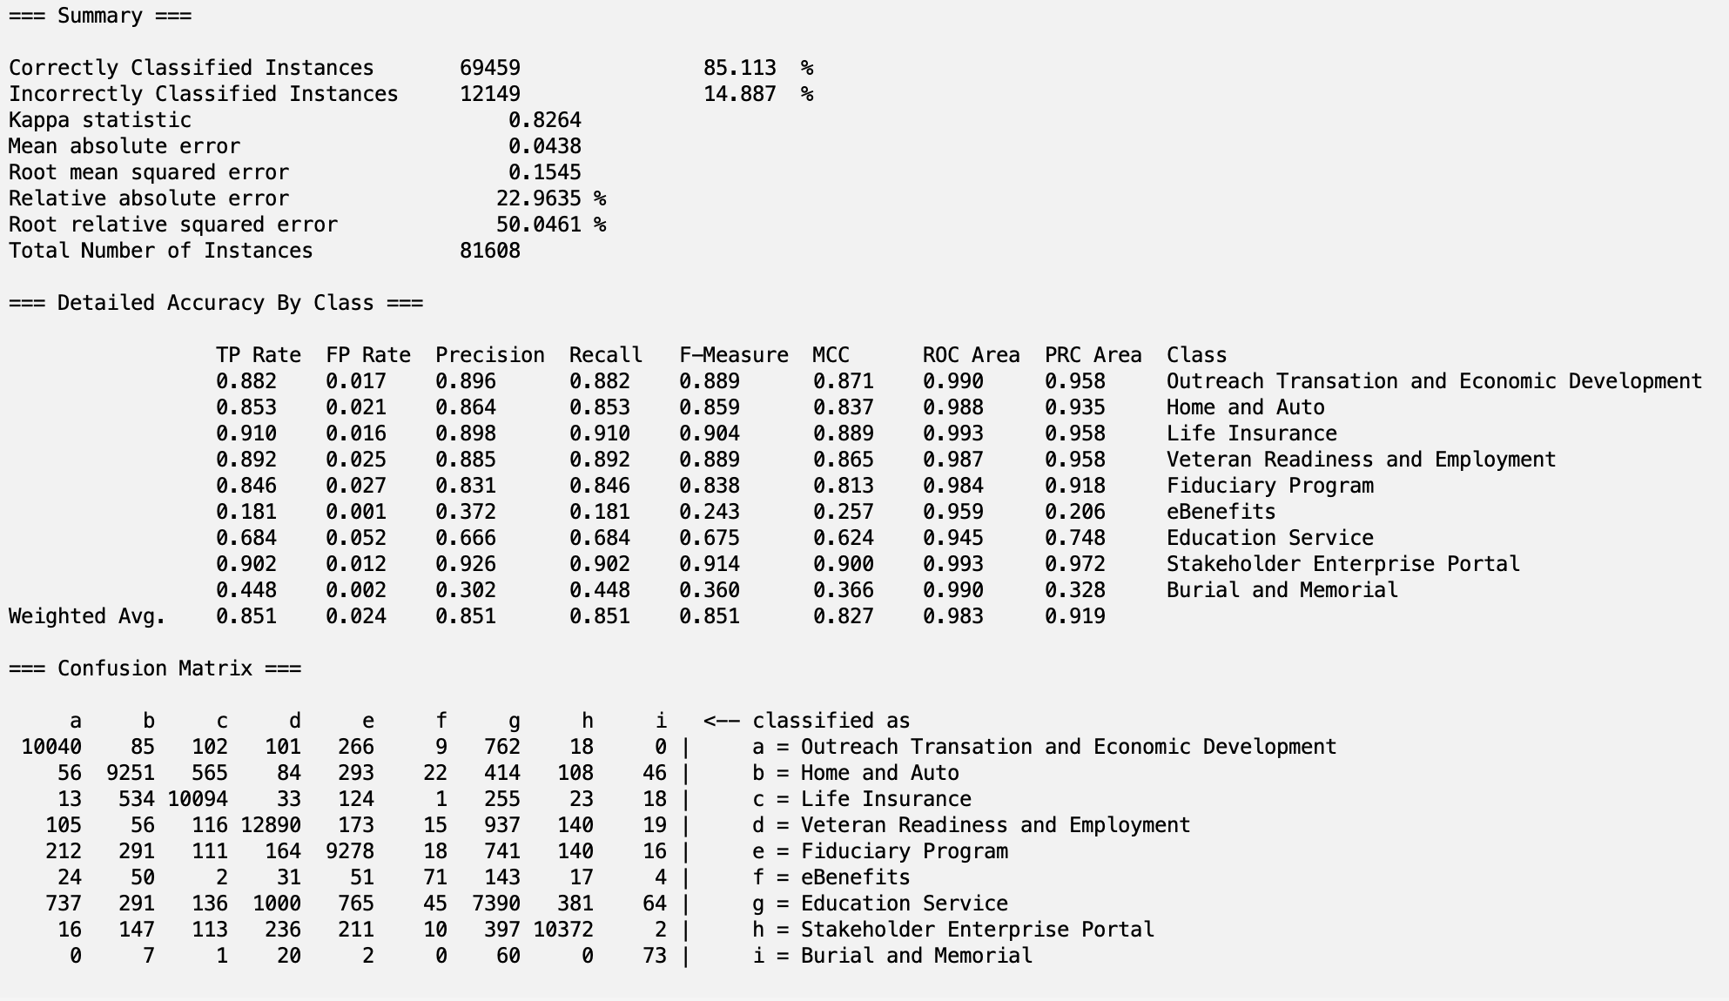
Correlation with Naive Bayes:
Results

Slide 39

Correlation with J48:
Results

Slide 40
Results
Table of Accuracy Values for Each Attribute Selection and Classification Combination
Attribute (Right) -------------------- Classification (Below) | No Attribute Removal | Principal Components Analysis | ReliefFAttributeEval | GainRatioAttributeEval | Correlation
Multilayer Perceptron | 98.53% | 96.63% | 86.39% | 83.21% | 83.82%
PART | 84.42% | 94.42% | 79.76% | 77.44% | 74.76%
Naives Bayes | 96.81% | 96.79% | 87.22% | 84.99% | 85.11%
J48 | 78.52% | 94.35% | 75.44% | 73.73% | 73.85%
Average: | 89.57% | 95.55% | 82.20% | 79.84%

Slide 41
Results
The best combinations were:
No Attribute Removal + Multilayer Perceptron (98.53%)
No Attribute Removal + Naives Bayes
Principal Component + Naives Bayes
Principal Component + Multilayer Perceptron
The worst combinations were:
GainRatioAttributeEval + J48 (73.73%)
ReliefFAttributeEval + J48
GainRatioAttributeEval + PART
No Attribute Removal + J48
ReliefFAttributeEval + PART

Slide 42
Purpose
The accuracy of 98.53 shows that embeddings are good
Embeddings can be used in further downstream tasks
RAG chatbot

Slide 43
Thanks!
Do you have any questions?
Please keep this slide for attribution

